Slide 1

RAPID RESPONSE
EMERGENCY AERIAL AI SERVICE
10X FASTER
5X LESS COST
100% MISSION SUCCESS

Slide 2
AGENDA
Introduction
M2 IAM Single (Sign On)
M2 CRM Sales Engine (Accts Contacts Activities)
M2 Customer Portal (Catalog & Orders)
M2 Customer Mission Mgt (Sorties, Flt Plans, Reports )
Customer Service (Tix & Resolutions)

Slide 3



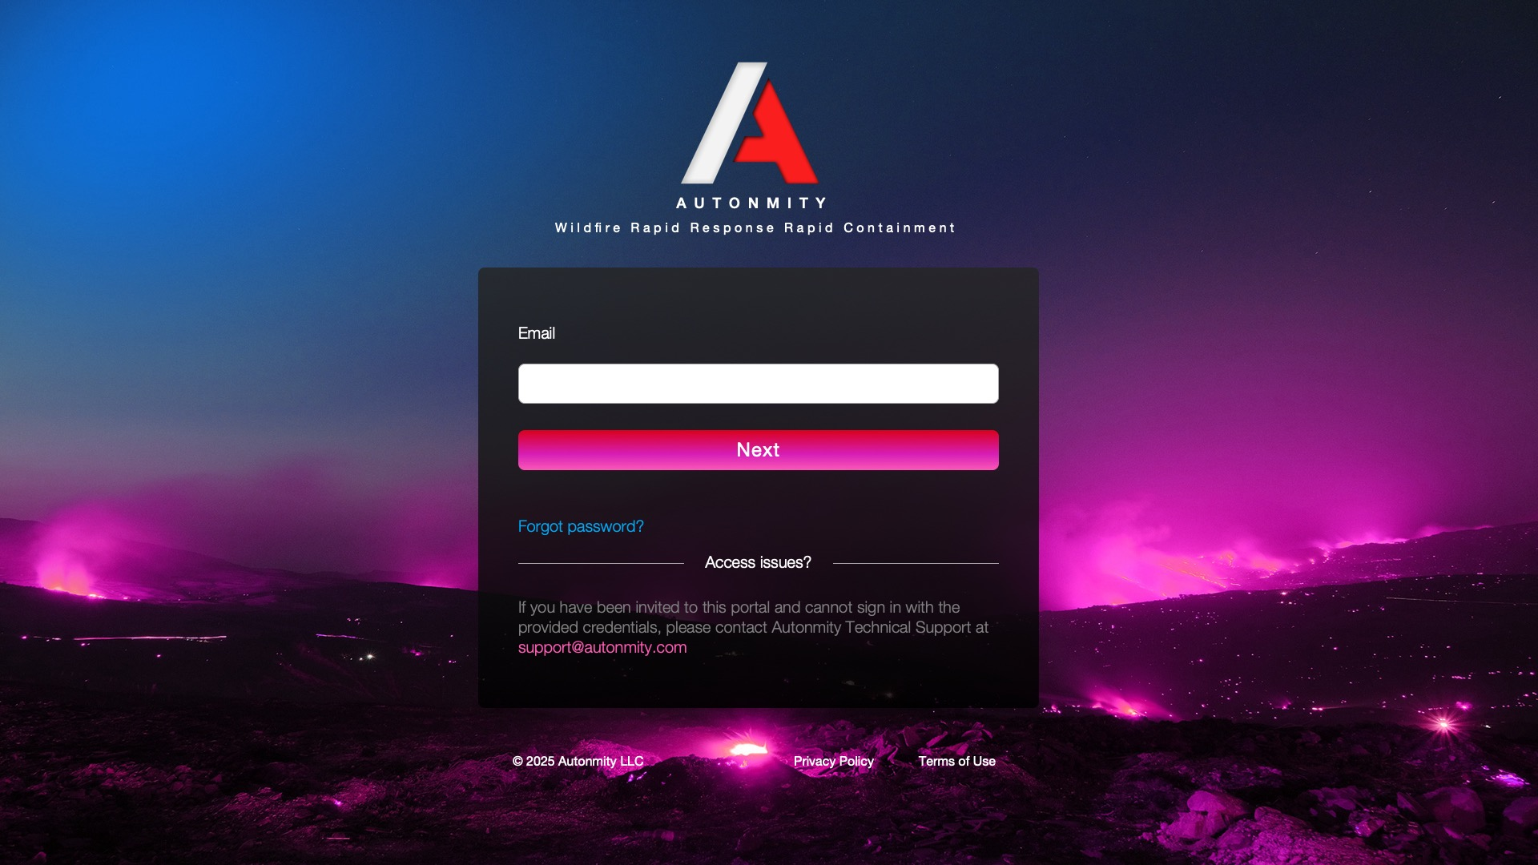

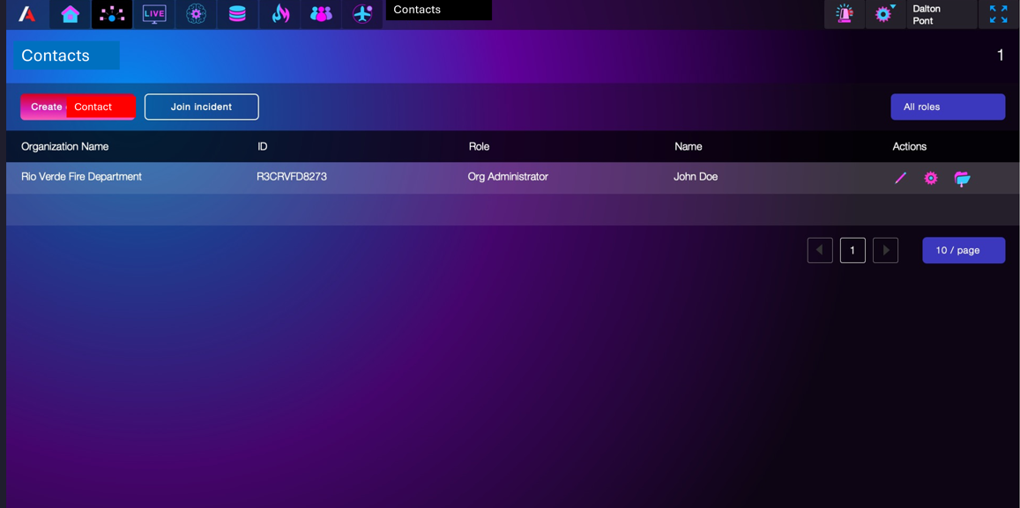


Introduction
Ops
(AutonOps)
Sales
(PRT)
Contacts
Activities
Customer
(RVFD)
Catalog
Catalog
Orders
Ops Sppt
AI Feeds
AI@AWS
(SDS)
Contacts
& Activities
(Via Outlook)
Portal
(AWS IAM)
Single sign On
Missions
Orders
C & C Data
SensFeed
Ops Support
Miss Pln, Flt Plns, Status,
Tix, Sen Feeds, AI Feeds, Reports
Sales Eng
(AWS M2 App)
Back Office
Aircraft
Collections
Payouts to Partners

Slide 4

SALES
Everybody is Sales
Capture Acct & Contact Info in Outlook
Retain Events in Outlook
At Close “On Board Users” Trans to M2 Platform
  Manually Transfer Outlook into M2 Sales Eng
  Train Custpmer’s SuperUser
  Customer Team Orientation
Outlook
Contacts
Events
Calls
Emails
Mtgs
At Close Export
M2
Sales Eng

Slide 5
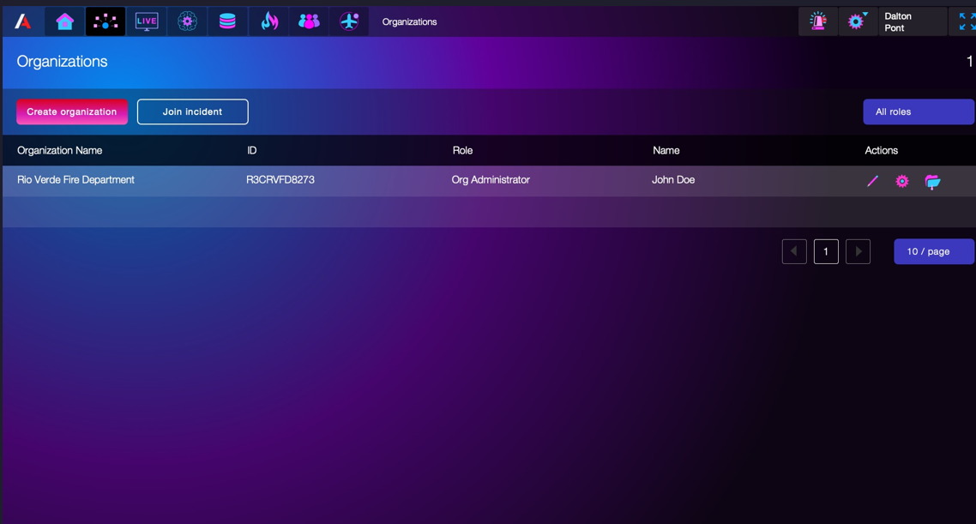
ORGANIZATIONS (Accounts)
At Close User On Boarding
Create New Orgs with Multiple Contacts
Accounts are manually created in M2 Sales Eng
Contacts are Manually Moved from Outlook into M2 Sales Eng
Activities are Manually Moved from Outkook to M2 Sale Eng
Accounts and Contacts Loaded into M2 IAM for Single SignOn

Slide 6
ORGANIZATION (Account Record)
RVFD
Contacts
Activities
Orders

Slide 7
CONTACTS Record
Each Org has a “Super User” to maintain their org and user records
Other Roles Can be
Chief
Commander
Ground Crew

Slide 8
CONTACTS Record

Slide 9
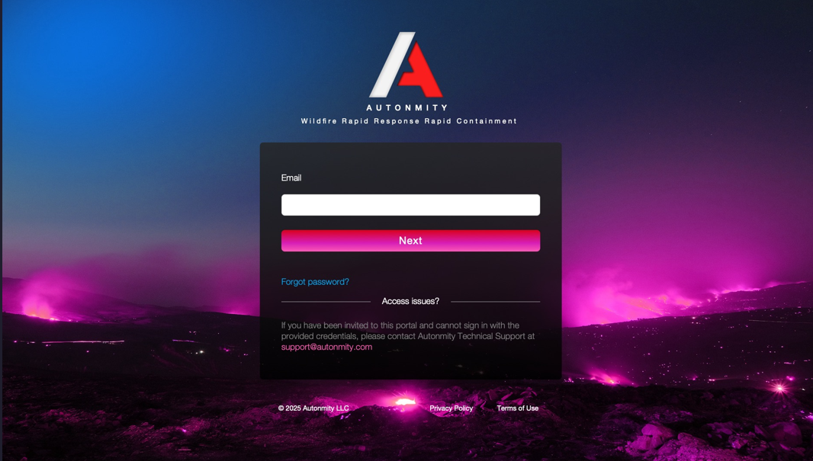
PORTAL
Gateway to Rapid Response Services
After Login Customers Can
Shop for Services
Learn More
Order Services
Manage Multiple Missions
Track Progress during Mission
Collaborate During Mission
Submit Issue Tix during Mission
Seek Mission Support during Mission
Eval & rate response during Incident
File After Action Reports
Customer Single Sign On (SSO)

Slide 10
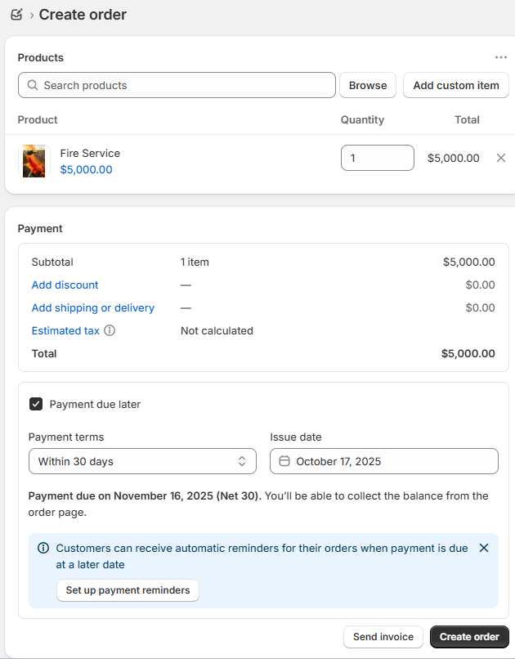
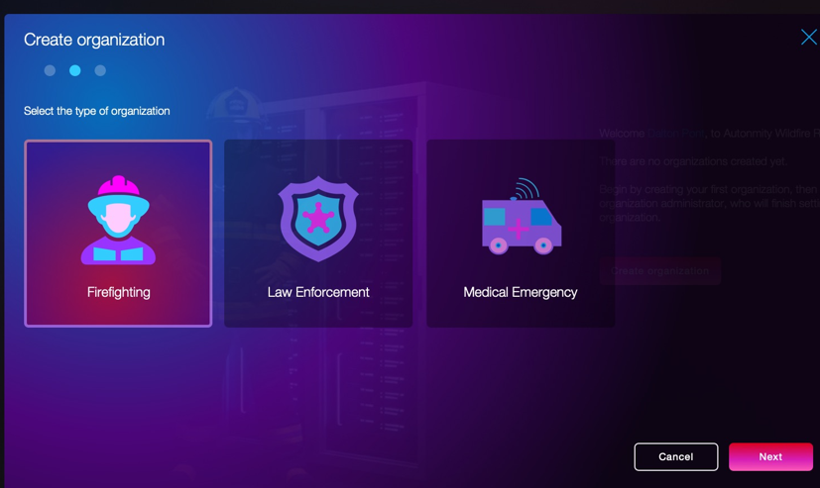

SERVICE SHOPPING
Service Order Form into Shopify
Order Service
Location
Select Type of Service
Recon
Notes

Slide 11
New Order = New Mission (Response)
Mission
Mission Details
ID
Name
Requestor
Notes
Order
Date
Account
Commander
Type
Location
Price
Mission Plan
SortID
Date
Time
Aircraft
Pilot
Controller
Status
SortID
Date
Time
Aircraft
Pilot
Controller
Status
SortID
Date
Time
Aircraft
Pilot
Controller
Status
SortID
Date
Time
Aircraft
Pilot
Controller
Status
SortID
Date
Time
Aircraft
Pilot
Controller
Status
Click ID to view/update Cortie

Slide 12
Sortie Flight Plan
Sportie Details
ID
Name
Requestor
Aircraft
Date
Account
Commander
Pilot
Type
Location
Price
Controller
Flight Plan
WPtID
Date
Time
Stage
AC Nav
Objective
Status
WPID
Date
Time
Stage
AC Nav
Objective
Status
WPID
Date
Time
Stage
AC Nav
Objective
Status
WPID
Date
Time
Stage
Pilot
Objetive
Status
WPID
Date
Time
Stage
Pilot
Objective
Status
Stages = PreFlight, Launch, Transit, Survey, Perform, Return, Land, PostFlight
Way Pt AC Nav = GeoLoc, Alt, Speed, Heading, Range Used, Range Remain, Sens On/Off, Pylad Events

Slide 13
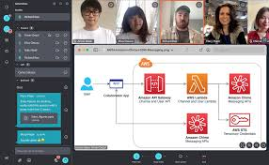
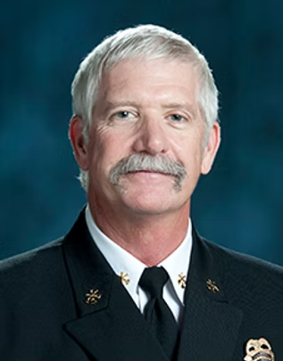




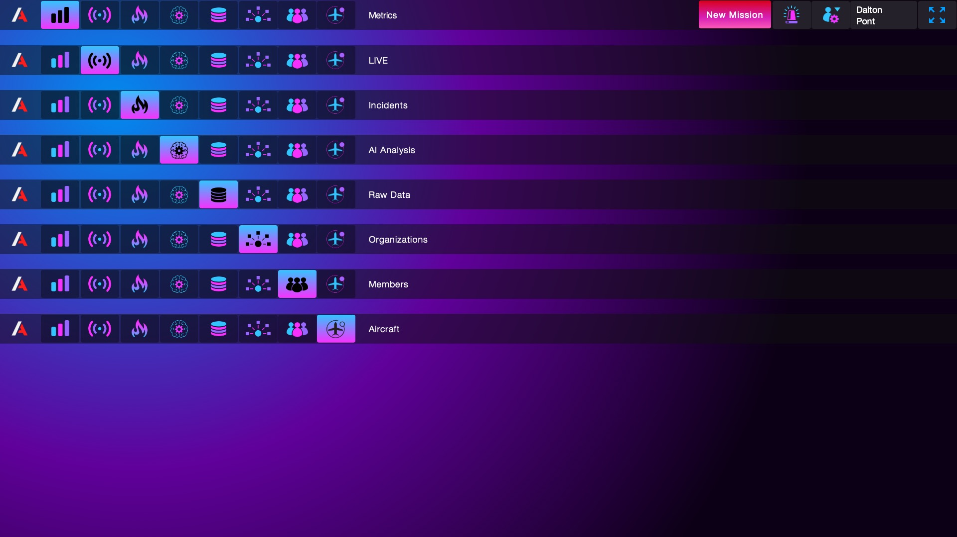



Multi-Mission Mgt (M2)
Click for Full Screen

Slide 14
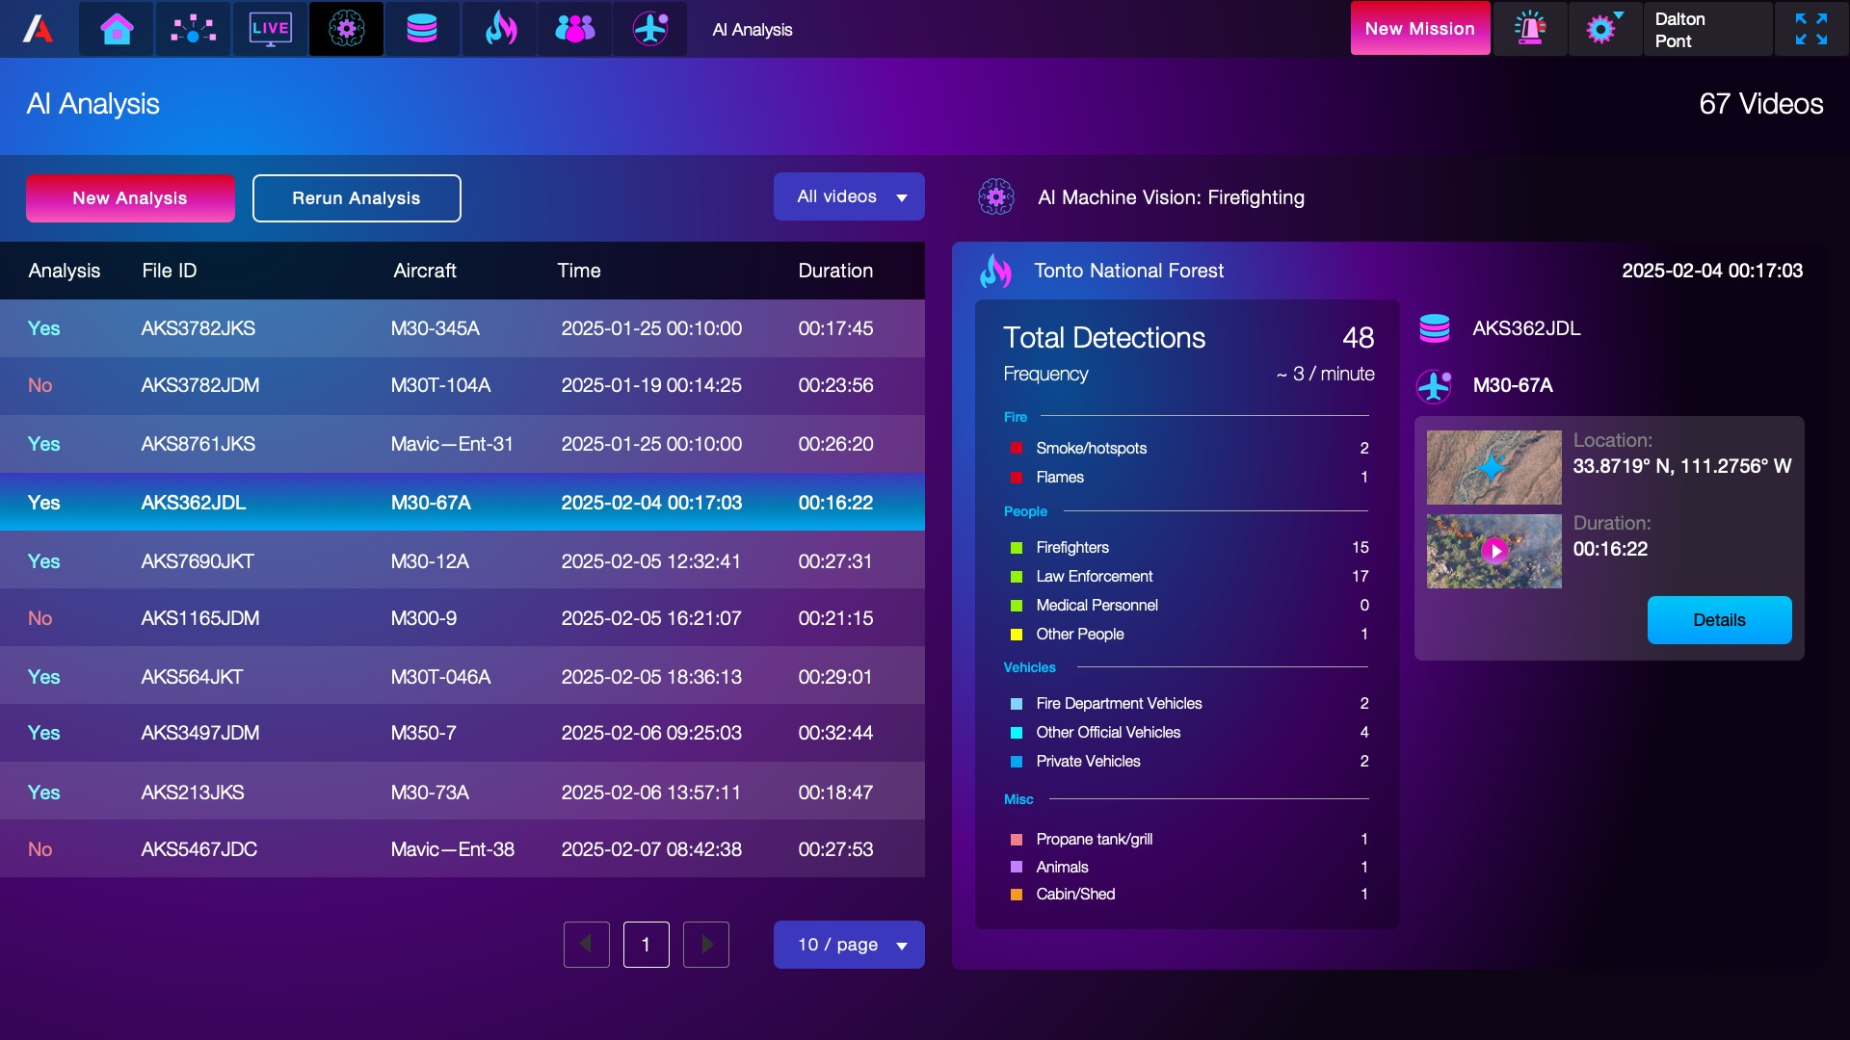
Missions
Click for Full Screen

Slide 15
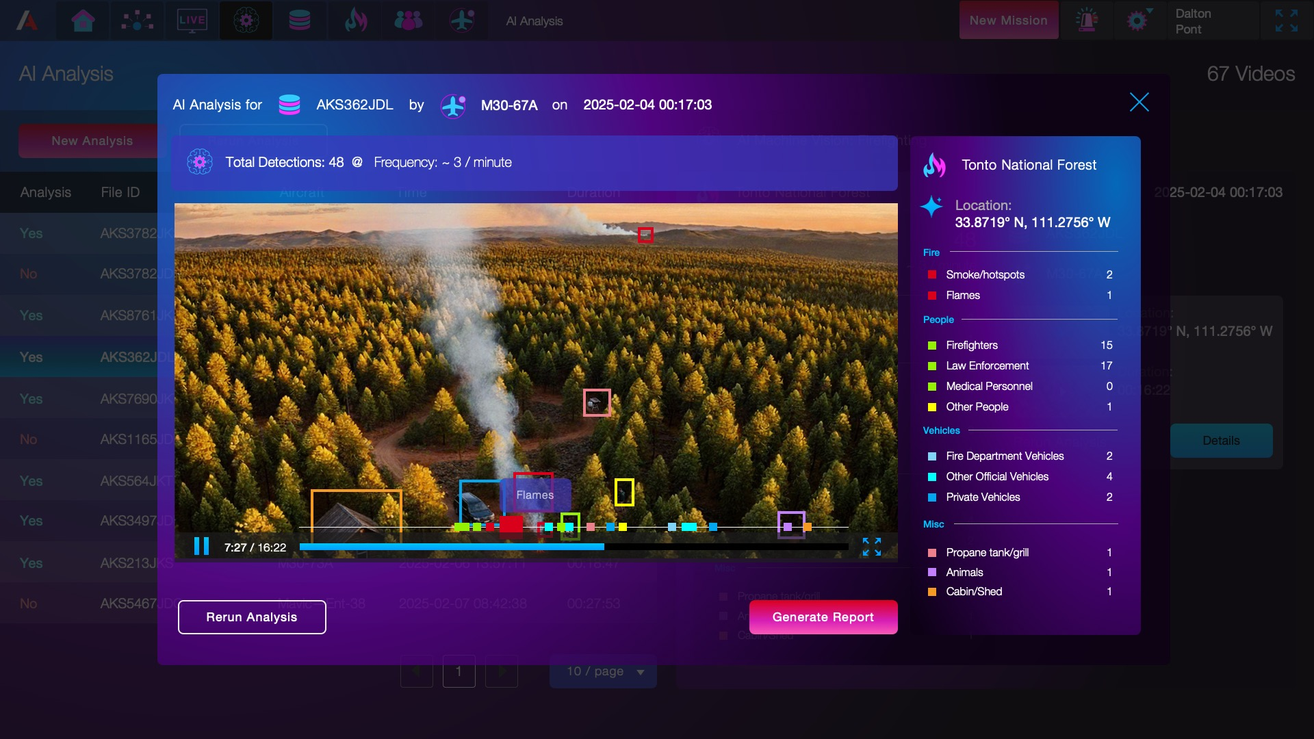
Missions AI Feeds
Click for Full Screen

Slide 16
Missions ( AFTER ACTION)
ATR Any Point, Cmdr Can Run AI-Gen AAR
All AARs Reviewed and Approved by Commabder
AI Generates ARR from Series of Sortie Summaries
AI Generates Mission Score from Sortie Ratings
AAR Approved are Retained in Mission Records
Source Data is Retained in Mission Records

Slide 17
THANK YOU
Kelly Ryan
240-723-0939
kryan@autonmity.com
www.autonmity.com

